Slide 1

Airbnb
New User booking Prediction

Slide 2

What is Airbnb?
Airbnb’s mission is to create a world where people can belong through healthy travel that is local, authentic, diverse, inclusive and sustainable. Airbnb uniquely leverages technology to economically empower millions of people around the world to unlock and monetize their spaces, passions and talents and become hospitality entrepreneurs.

Slide 3

About
Founded in 2008. Airbnb’s accommodation marketplace provides access to 7 million unique places to stay in more than 100,000 cities and 191 countries and regions. With Experiences, Airbnb offers unprecedented access to local communities and interests through 40,000 unique, handcrafted activities run by hosts across 1,000+ cities around the world. Airbnb’s people-to-people platform benefits all our stakeholders, including hosts, guests, employees and the communities in which we operate.

Slide 4

New user booking
New users on Airbnb can book a place to stay in 34,000+ cities across 190+ countries. By accurately predicting where a new user will book their first travel experience, Airbnb can share more personalized content with their community, decrease the average time to first booking, and better forecast demand.

Slide 5


Given a datasets of feature about the users I need to create a classification model which can predict where will be the user first booking depending on his behavior , gender , age and more features There are 12 possible outcomes of the destination country: 'US', 'FR', 'CA', 'GB', 'ES', 'IT', 'PT', 'NL','DE', 'AU', 'NDF' (no destination found), and 'other'.
Problem description (business)
In this challenge, I am given a list of users along with their demographics, web session records, and some summary statistics, I need to predict which country a new user's first booking destination will be. All the users in this dataset are from the USA.
Problem description (technical)

Slide 6
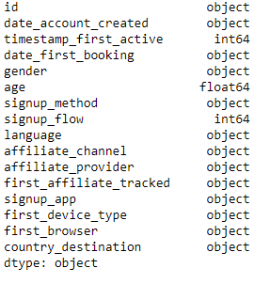
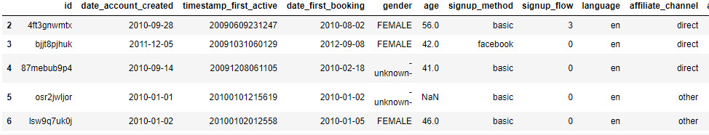
USER Data exploration
By exploring user data I found that there is 15 feature for each user and a country_destination which is out target to predict

Slide 7
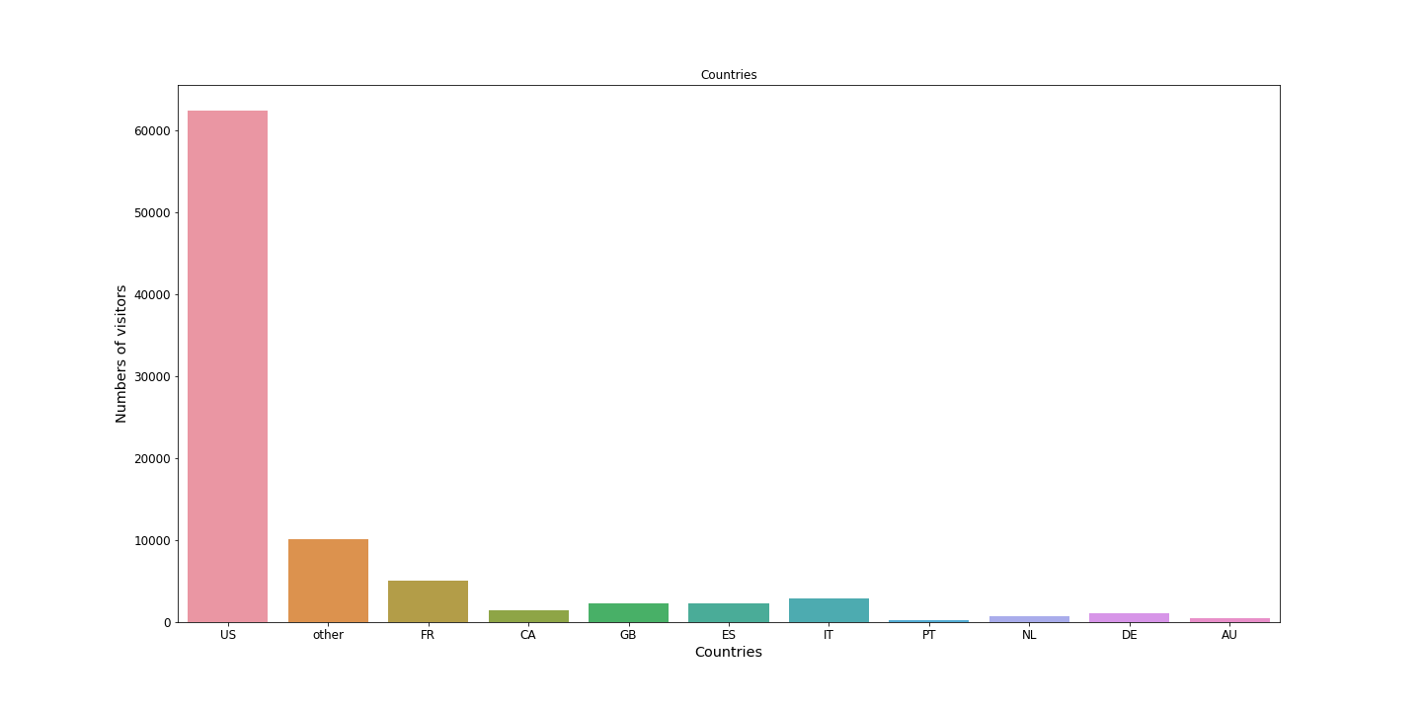
Country Destination
By visualizing destinations I found that the most visited country is US
which is predicted since all the user we have are from USA .

Slide 8
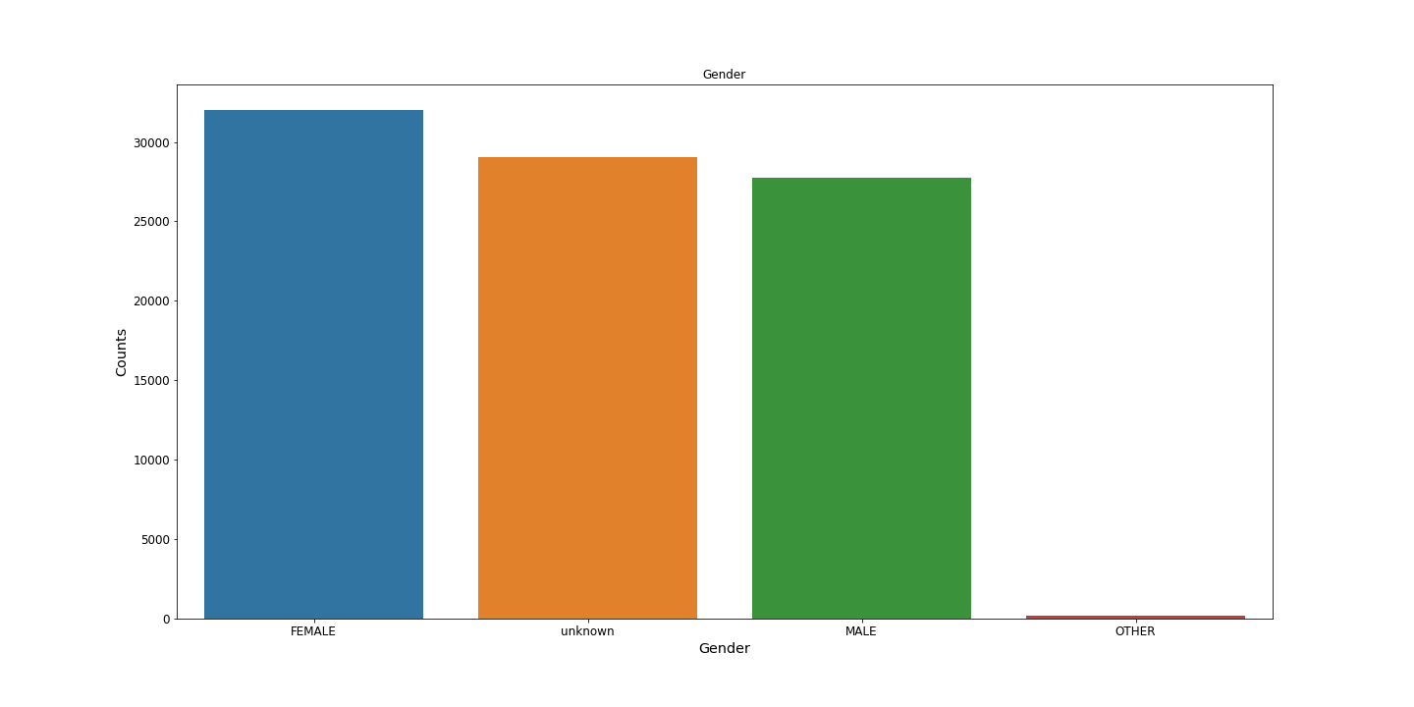
User Gender
Now we will have a look for the users gender to have a better look for the gender distribution among our data .
I found the female users are more than males , And also I found a problem in the data that some users hasn’t defined there gender .

Slide 9
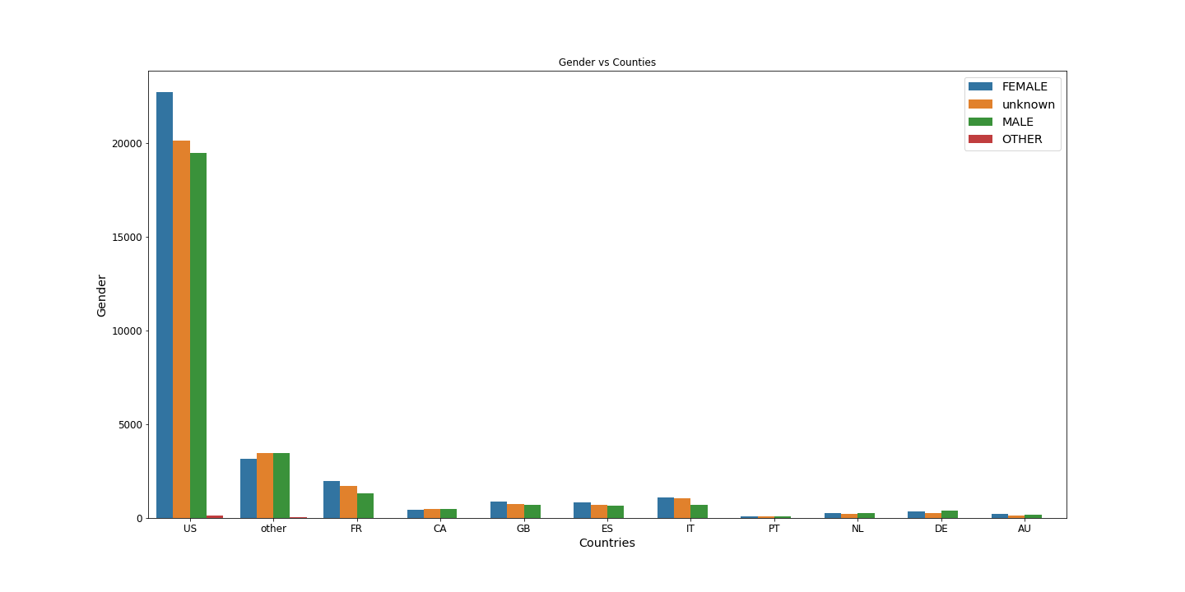
User Gender
By having a look at the gender distribution among the visited destination fount that more males visit CA , DE and PT
than females , While female prefer FR , GB and ES .

Slide 10
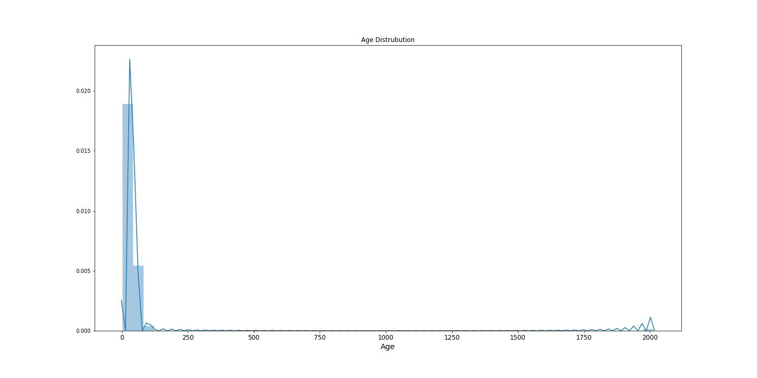
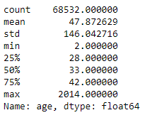
User age
Visualizing and getting statistics about the age showed another problem in our data .
With min age = 2 and max age = 2014

Slide 11
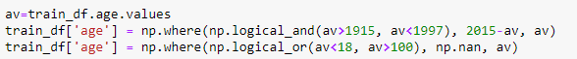
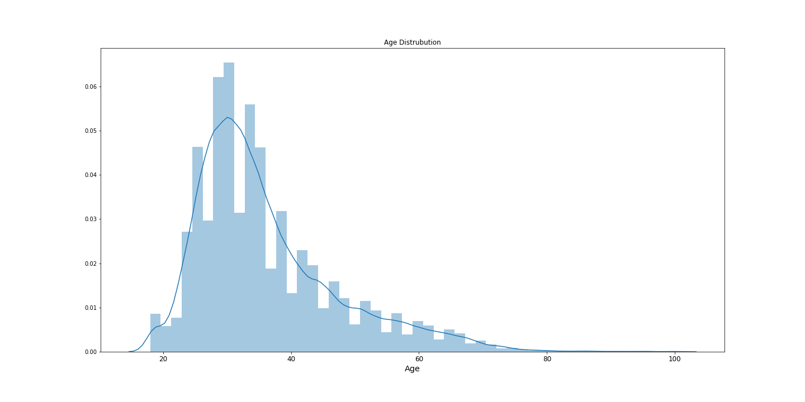
User age
After dealing with the age data I had now a better look for the age distribution among the data . It seems that people
From 20 to 40 years old tends to travel more than others .

Slide 12
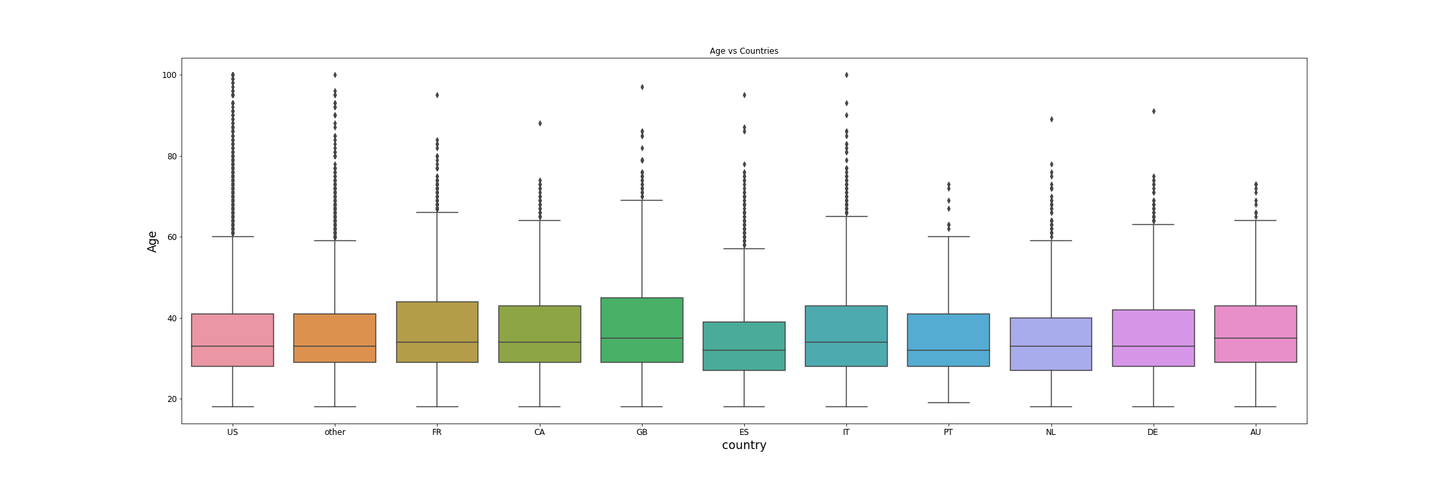
User age
By having a look at the age distribution among the visited destination fount that older users tends to visit FR , GB and IT
While younger users prefer US and ES

Slide 13
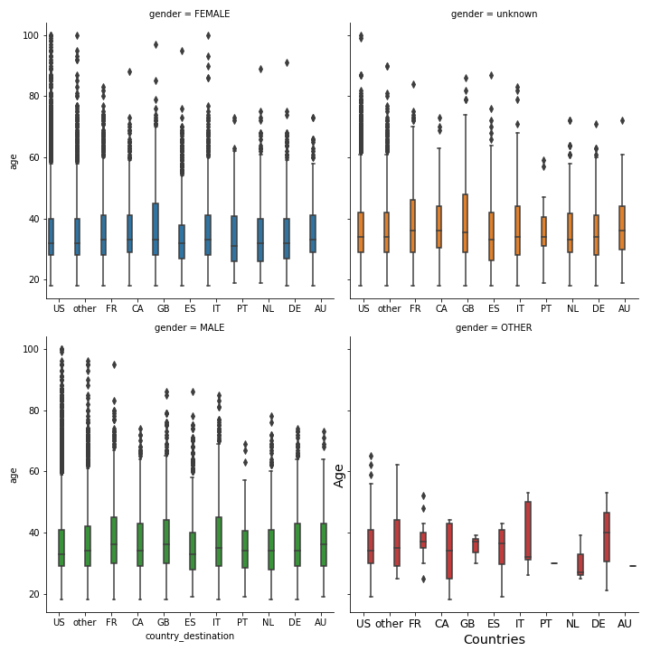
User age
By having a look at the age distribution for each gender among the visited destination fount that older females prefer US
and GB more than older males while younger males prefer NL and PT more .

Slide 14
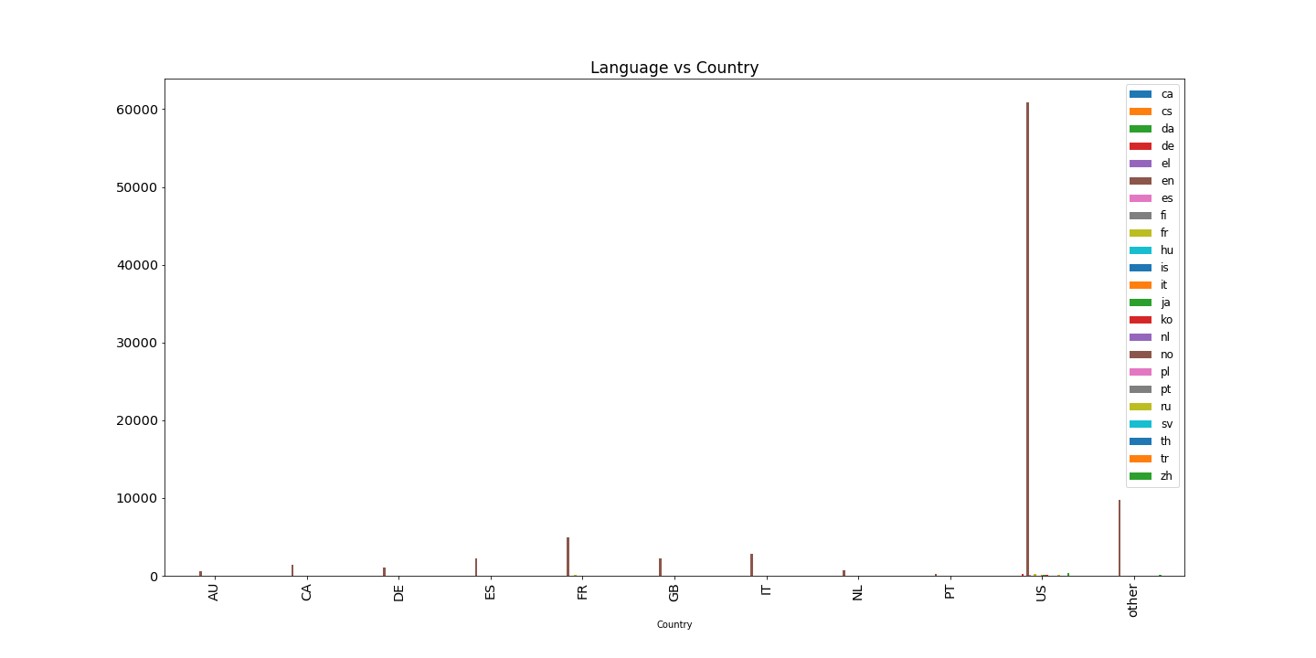
User language
Looking at the users language data we can tell that most of them prefer English .
English language is almost 98% of the used language for the users .

Slide 15
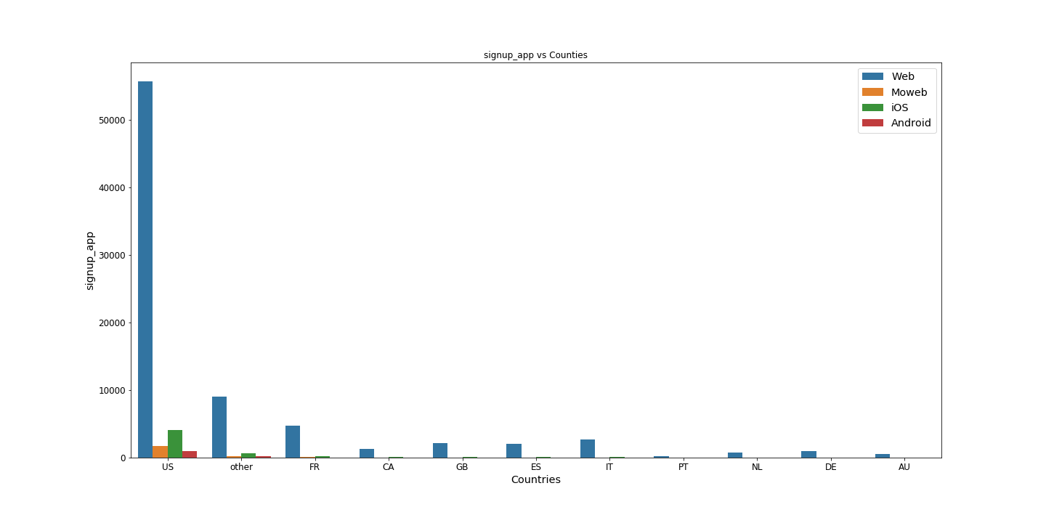
Signup app
Now by checking the most signup app used by user against the country of destination we can figure out that most users
Prefer signing up using the web site and then comes iOS .

Slide 16
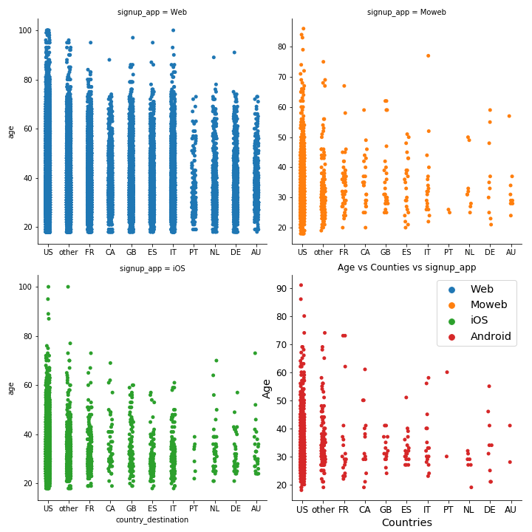
Signup app
By comparing age and signup_app with country we can tell that all ages using web tends to visit US more and users who
Signup by Moweb don’t tend to visit PT and Android user don’t prefer AU or PT also .

Slide 17
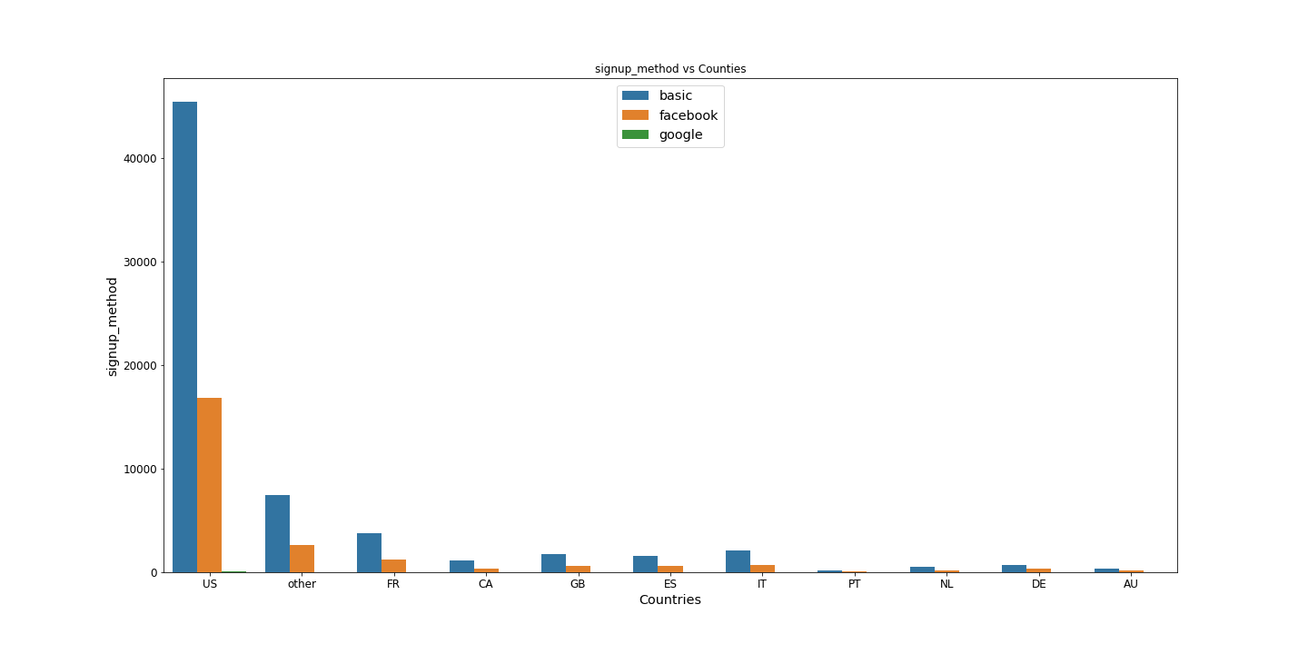
Signup method
Most people travelling to us prefer using the website for sign-up (basic method) .

Slide 18
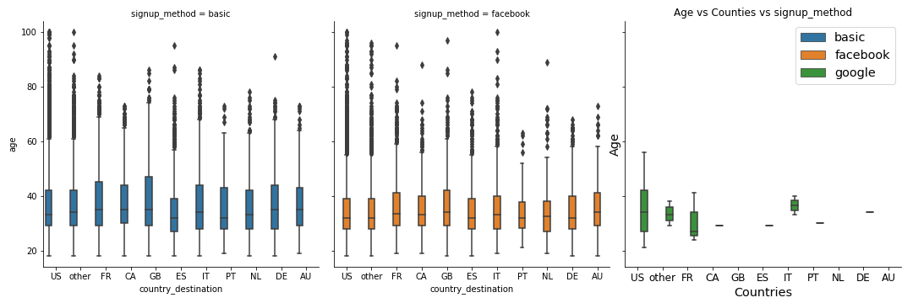
Signup method
Comparing the age with the signup method those who use google prefer US , FR and IT and older people using basic
Method prefer GB while younger prefer ES .

Slide 19
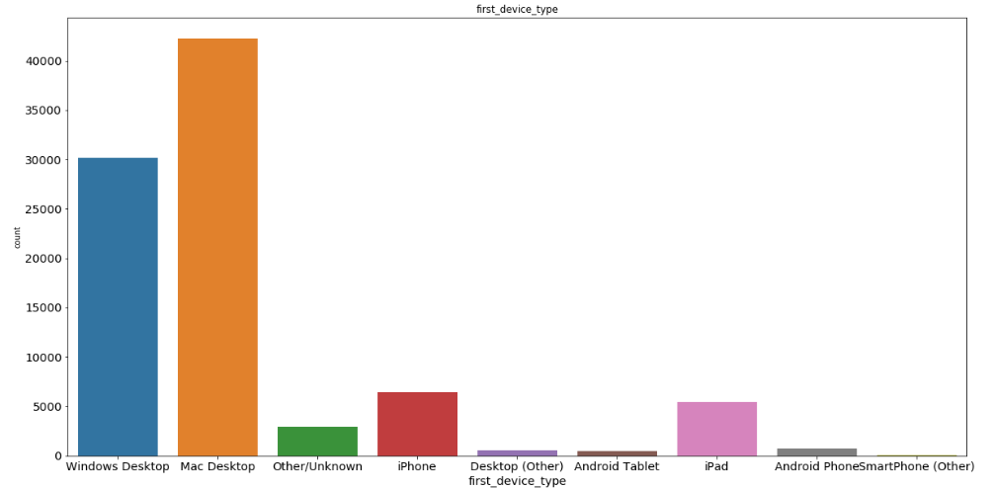
Device used
Most users prefer Mac Desktop then windows desktop .

Slide 20
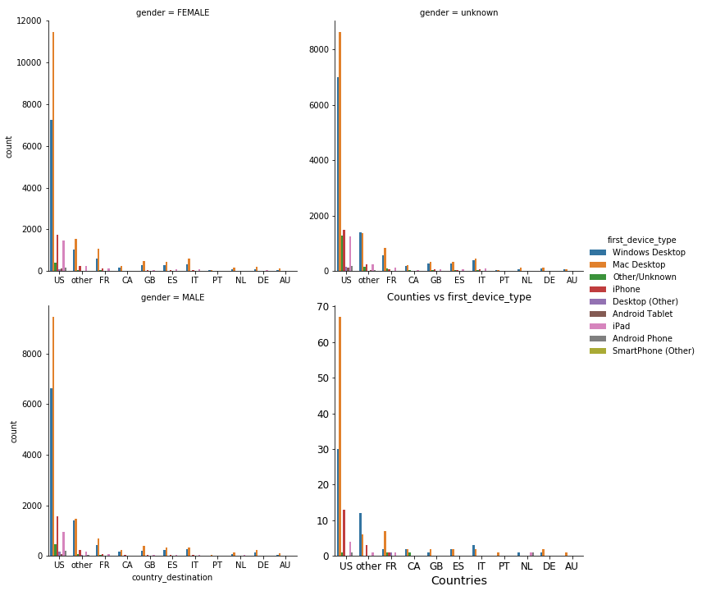
Device used
By exploring the device used with the gender and country destination still most users prefer Mac Desktop regardless
to there gender or the country destination .

Slide 21
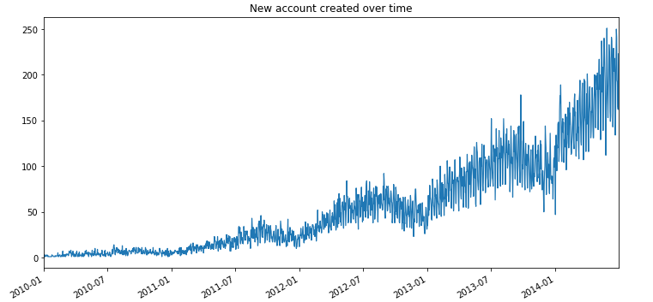
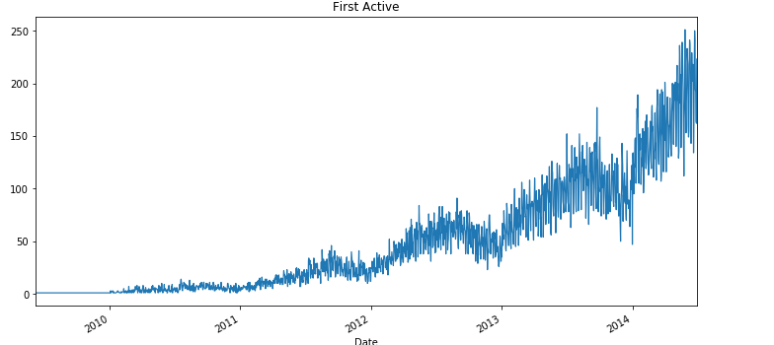
Dates
There is a huge jump in creating new accounts and first active time after 2014 .

Slide 22
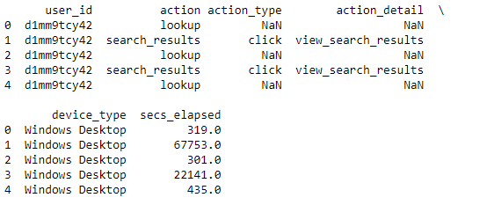
Session Dataset
Session dataset contain information about users sessions during browsing Airbnb like the action (lookup – search )
And the action type ( click – hover ) and the action detail and time elapsed in every action in seconds .

Slide 23
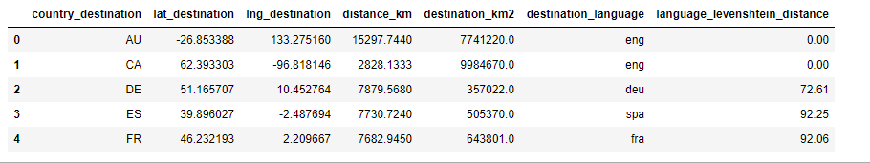
Countries dataset
Country data set contain information about 10 countries in the country_destination target like the
Latitude longitude and the distance .
It can be used to draw a map of our visited countries according to number of visits .

Slide 24
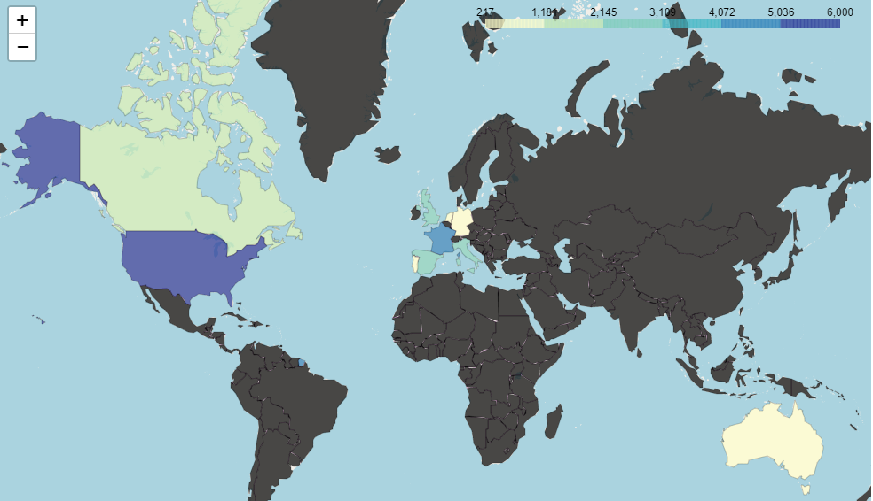
Countries

Slide 25
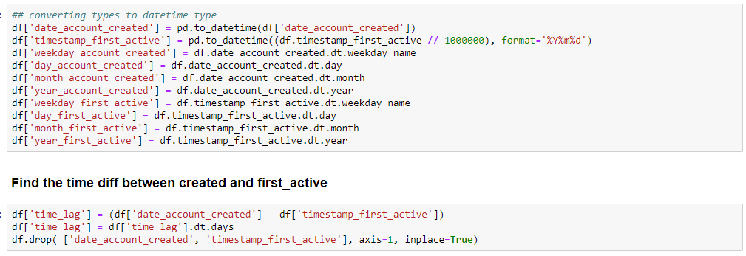
Classification Model
Changing the date of signup and first active to datetime type and getting the month and year and weekday and day
to add more feature for our model and also adding another feature is the difference between signup and first active .

Slide 26
Classification Model
According to Airbnb minimum age required to make a booking is 18 years old so we need to change all of those under 18
and also the reasonable maximum age to travel and make a booking is 100 .
Also we need to correct the wrong values for those who entered their year of birth instead of the age .
Finally we need to fill the empty ages with the mean of all ages .

Slide 27
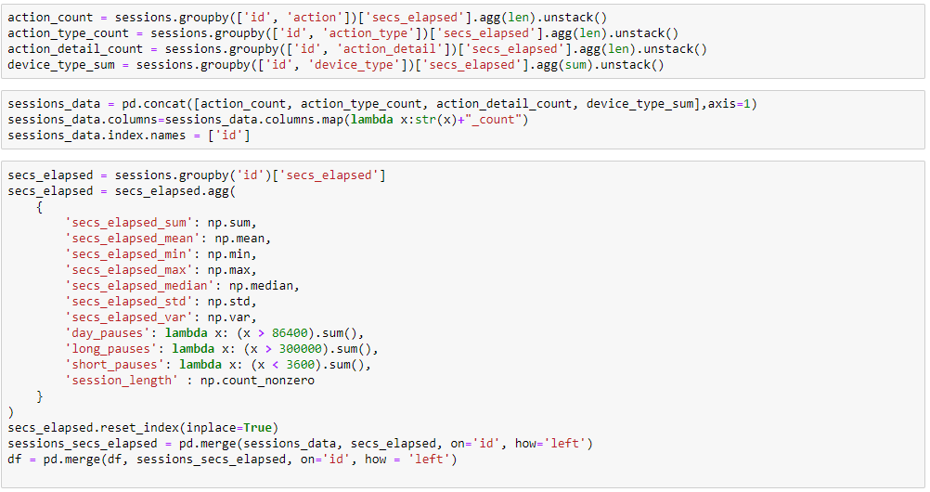
Classification Model
Now we need to extract features from the sessions dataset like the actions type and action detail and the device used ,
Also we need to do some aggregation on the time elapsed between every action and the pauses time interval between
actions .

Slide 28
Classification Model
After getting all the features ready we need to get a numerical value for each variable in the categorical variables .
Since Machine learning algorithms can only deal with numerical variables .
Also we need to encode the target variable .

Slide 29
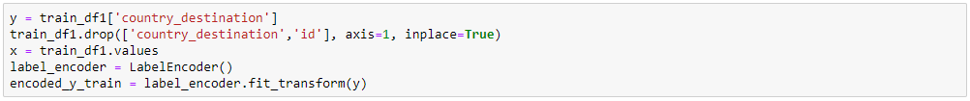
Classification Model
After getting all the features ready we need to get a numerical value for each variable in the categorical variables .
Since Machine learning algorithms can only deal with numerical variables .
Also we need to encode the target variable .

Slide 30
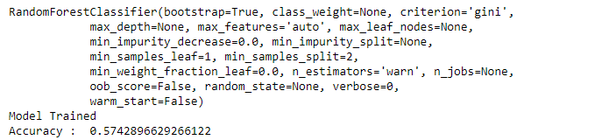
Classification Model
Approaches
1-Random Forest

Slide 31
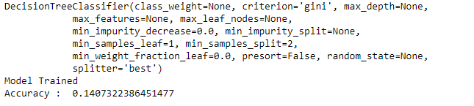
Classification Model
Approaches
2- Decision Tree

Slide 32
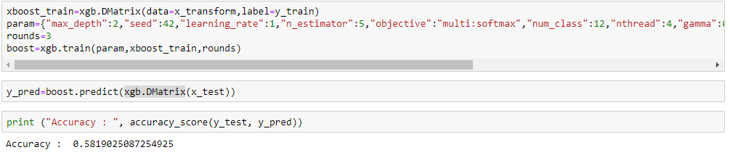
Classification Model
Approaches
3- XGBOOST

Slide 33
Classification Model
Result
XGBOOST Classifier has the best accuracy among the three model 58%.
The accuracy can be increased in the future by doing some feature engineering
techniques and feature selection .

Slide 34

Thank you
MOHAMED_MAGDY92@LIVE.COM
01111102793

